Slide 1



Slide 2

Presentation Topic:
Working Or Functionality Of:
IBM Iapx-8088 Microprocessor
Control Bus
Data Bus
Address Bus
Group Members:
MARIAM KHALIL {21-ARID-439}
M. SARIB RASHID {21-ARID-472}
SAHADAT ALI SHAH {21-ARID-519}

Slide 3
What Is Microprocessor?
An integrated circuit that contains all the functions of a central processing unit of a computer.
Why We Use Microprocessor?
It can function as the “brain” of a personal desktop computer. A computer's microprocessor performs arithmetic and logic operations, provides temporary memory storage, and times and regulates all elements of the computer system.

Slide 4
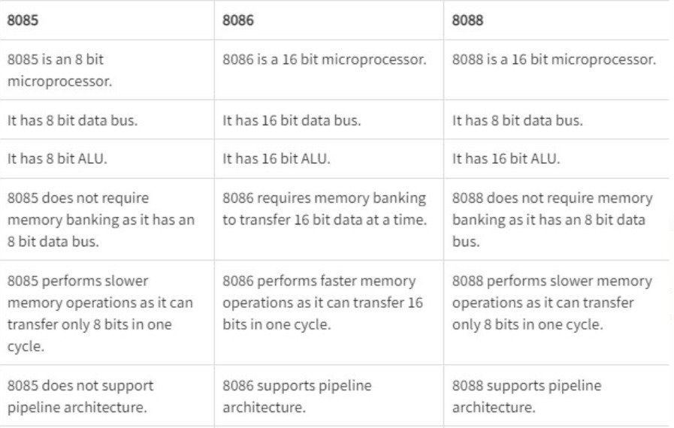
Comparison between Microprocessors:

Slide 5
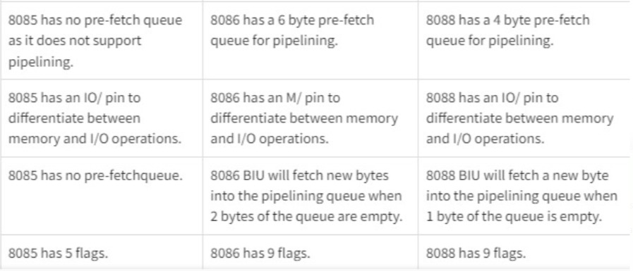

Slide 6
8085 MICROPROCESSOR
The 8085 is an 8-bit microprocessor introduced by Intel in 1976.
It is part of the MCS-85 family and is considered a successor to the 8080/8080A microprocessor.
The 8085 operates at a clock speed of up to 3 MHz and has an 8-bit data bus and a 16-bit address bus.
It supports a maximum of 64 KB of memory through its memory addressing capabilities.
The 8085 uses a single accumulator (A) along with six general-purpose registers (B, C, D, E, H, and L) to perform arithmetic and logical operations.
It features various flags to indicate the status of operations, including carry, zero, sign, parity, and auxiliary carry.
The 8085 incorporates a variety of instructions for data manipulation, arithmetic and logical operations, branching, and I/O operations.

Slide 7
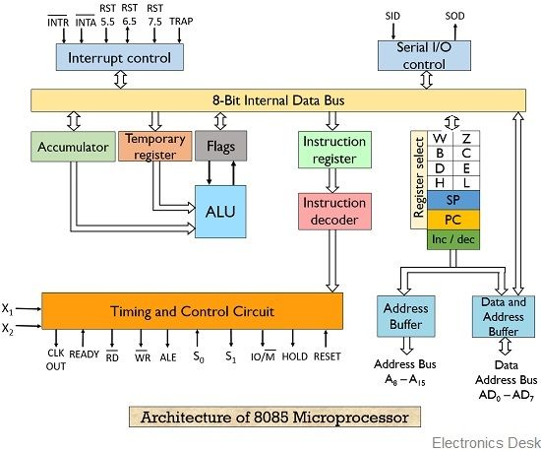

Slide 8
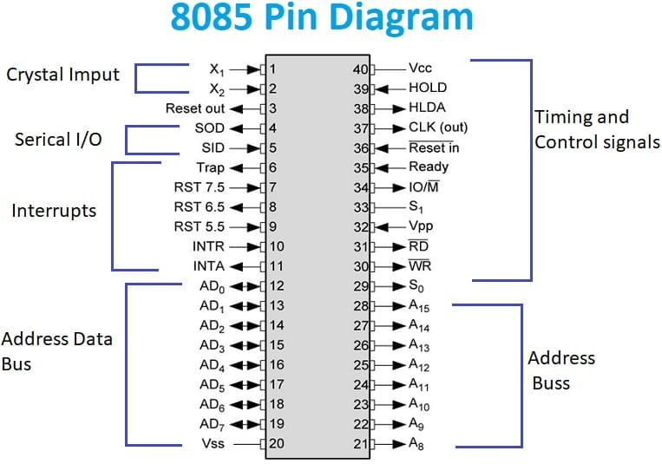

Slide 9
8086 MICROPROCESSOR
The 8086 is a 16-bit microprocessor introduced by Intel in 1978.
The 8086 operates at a clock speed of 5 MHz.
It has 16-bit data bus and a 20-bit address bus.
It supports a maximum of 1 MB of memory through its segmented memory model.
The 8086 uses a complex instruction set architecture (CISC) with a wide range of instructions and addressing modes.
It has 14 general-purpose registers, including the AX, BX, CX, DX, SI, DI, BP, and SP registers.
The 8086 features four segment registers: CS (code segment), DS (data segment), SS (stack segment), and ES (extra segment).
It supports both real mode and protected mode operation. In real mode, the processor operates similarly to its predecessors, while in protected mode, it provides memory protection and multitasking capabilities.

Slide 10
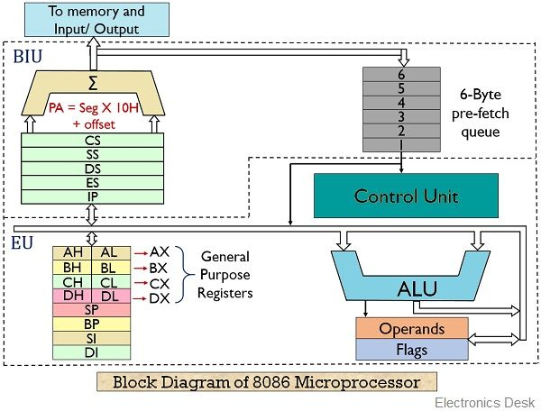
8086

Slide 11
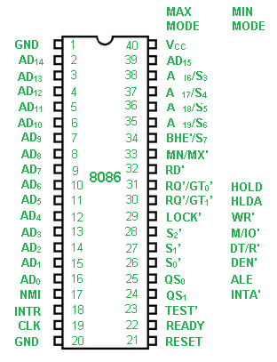
8086

Slide 12
8088 MICROPROCESSOR
The 8088 is a microprocessor introduced by Intel in 1979 as a variant of the 8086.
It is a 16-bit processor, but with an 8-bit external data bus, which makes it compatible with lower-cost 8-bit systems.
The 8088 operates at a clock speed of 5 MHz, similar to the 8086.
It has a 16-bit internal architecture, including 16-bit registers and a 20-bit address bus like the 8086.
It uses a multiplexed address and data bus, meaning that the same pins are used for both address and data transfer, which simplifies system design.
The 8088 features four segment registers (CS, DS, SS, and ES) similar to the 8086.
It supports the same instruction set as the 8086, including various addressing modes and a wide range of instructions.
Due to its compatibility with 8-bit systems, the 8088 was widely adopted in early personal computers, including the original IBM PC released in 1981.

Slide 13
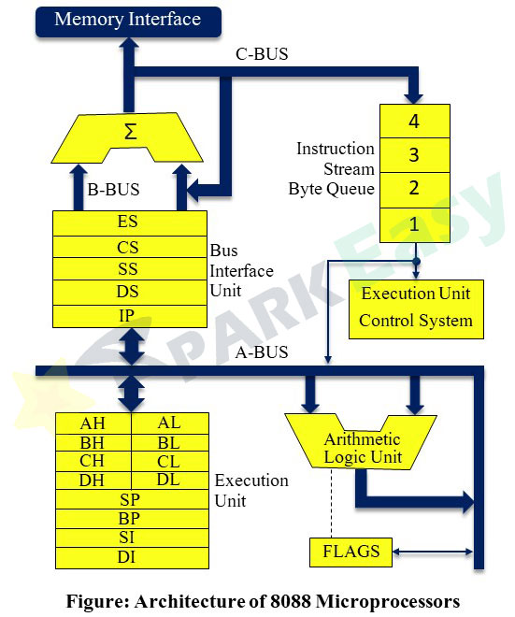

Slide 14
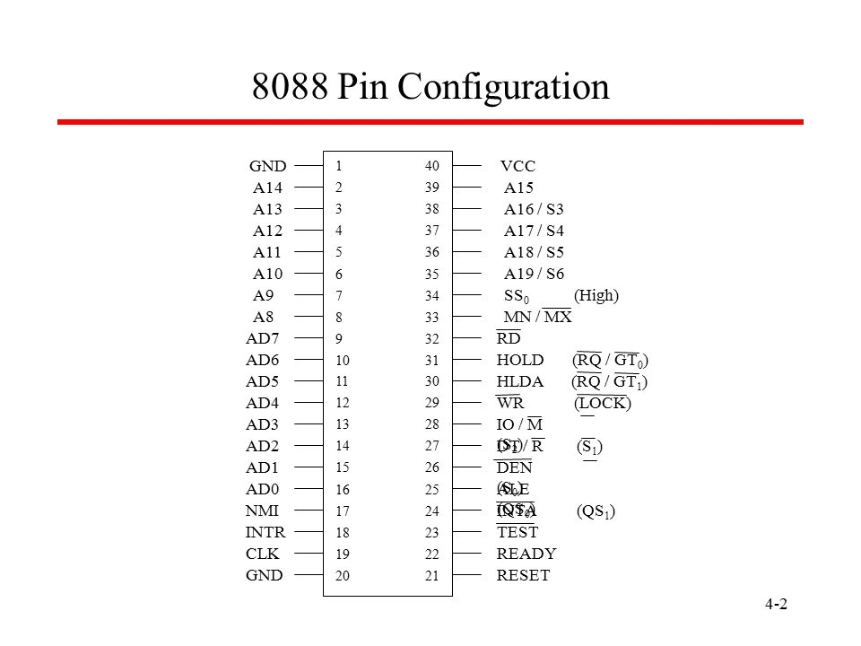

Slide 15
Buses
What Is Bus?
A bus is a link between components or devices connected to a computer.
For example, a bus carries data between a CPU and the system memory via the motherboard.

Slide 16
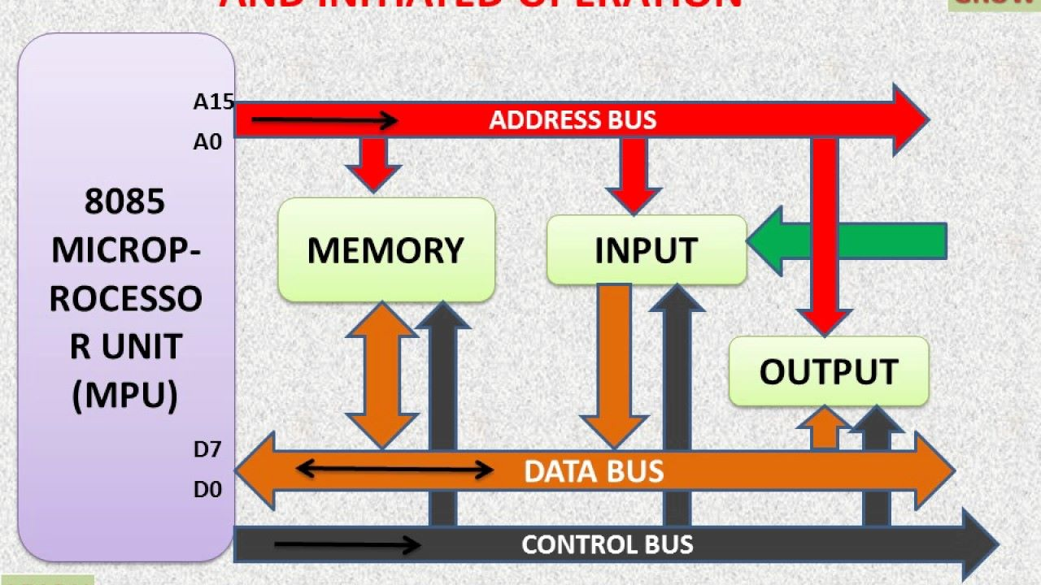
Why We Use Buses?
Buses are used to send control signals and data between the processor and other components.
Diagram of Bus:

Slide 17
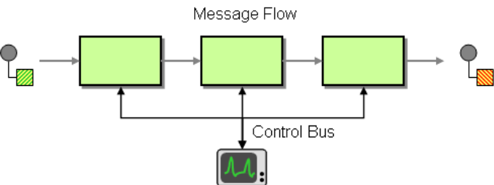
Control Bus:
The control bus is a communication pathway used by the Central Processing Unit (CPU) of a computer system to send and receive control signals to and from other components such as memory and input/output devices.
The control bus consists of a group of wires that carry control signals such as read, write, and interrupt requests.

Slide 18
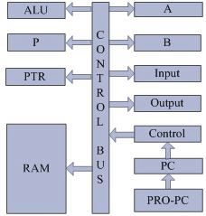
Block Diagram Of Control Bus:

Slide 19
Working Of Control Bus:
The control bus plays a crucial role in coordinating the activities of the different components of a computer system.
When the CPU wants to perform an operation such as reading or writing data to memory, it sends a control signal over the control bus to the memory controller indicating the type of operation it wants to perform.
The memory controller then responds by sending a signal indicating whether the operation was successful or not.

Slide 20
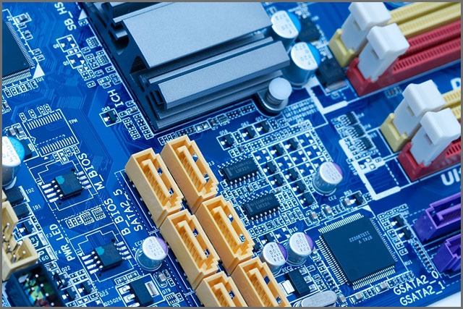
Data Bus:
The data bus is another communication pathway in a computer system that is responsible for transmitting data between the CPU, memory, and input/output devices.
The data bus is a set of wires that carry data in the form of binary digits (bits).

Slide 21
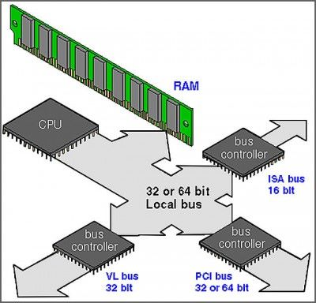
Internal View Of Data Bus:

Slide 22
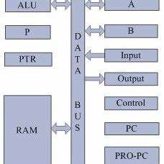
Block Diagram Of Data Bus:

Slide 23
Working Of Data Bus:
When the CPU wants to read data from memory or an input/output device, it sends a memory address over the address bus, which specifies the location of the data.
The memory or input/output device responds by sending the requested data over the data bus to the CPU.

Slide 24
Similarly, when the CPU wants to write data to memory or an input/output device, it sends the data over the data bus to the memory or input/output device.
The memory or input/output device stores the data at the specified memory location.

Slide 25
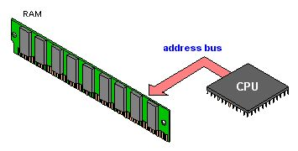
Address Bus:
The address bus is a communication pathway in a computer system that is responsible for transmitting memory addresses from the CPU to memory and input/output devices.
The address bus consists of a set of wires that carry the memory addresses, which specify the location of data in memory or input/output devices.

Slide 26
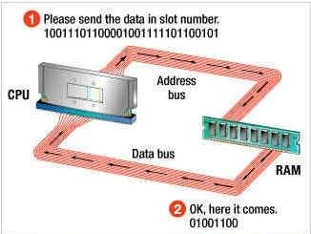
Diagram Of Address Bus:

Slide 27
Working Of Address Bus:
When the CPU wants to read or write data, it sends the memory address over the address bus to the memory or input/output device.
The memory or input/output device then responds by sending the requested data over the data bus to the CPU or by receiving the data sent by the CPU.

Slide 28

THANK
YOU

